Slide 1
PROG 8460 Final Exam
Web Analytics and Business Intelligence Tools
Obiora Felix Ukwuani_8984289_Final

Slide 2
Data-Driven Insights COVID-19 Trends; Online Sales Performance Analysis

Slide 3
Tracking the Pandemic Across Continents and Time
The COVID-19 pandemic greatly affected global health and economies, with varying impacts across countries and regions.
This analysis explores key trends such as positive cases, death counts, and the reliability of data sources.
Using interactive dashboards and visualizations, it provides a clear view of how the pandemic progressed and its impact worldwide, supporting informed decision-making.

Slide 4
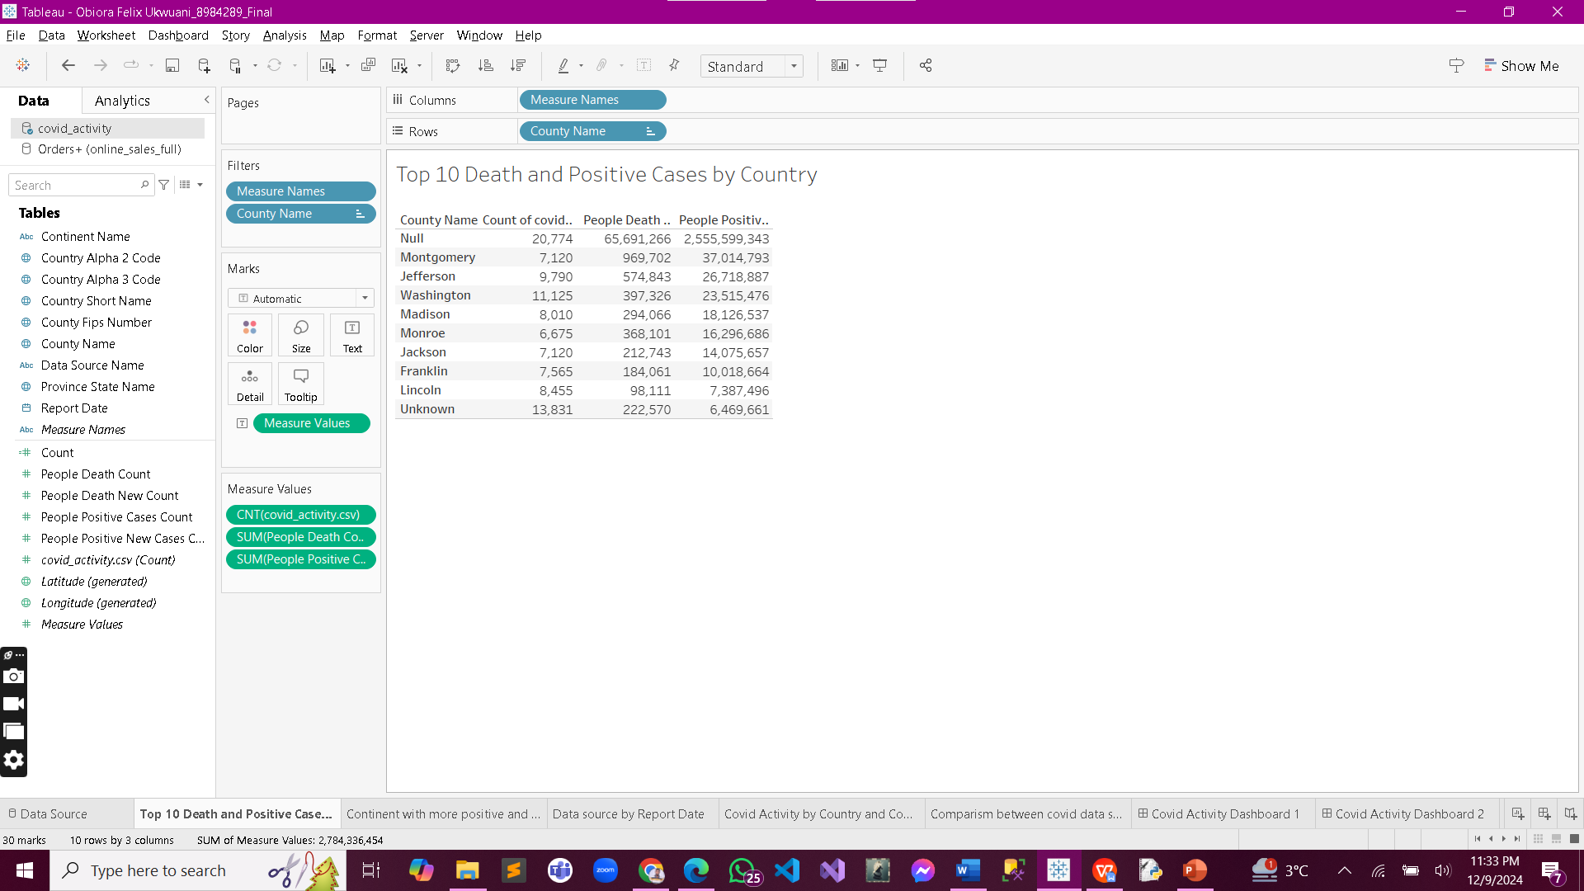
Top 10 Death and Positive Cases by Country
This visualization highlights the countries with the highest death and positive case counts, emphasizing global hotspots/hardest hits areas during the pandemic.

Slide 5
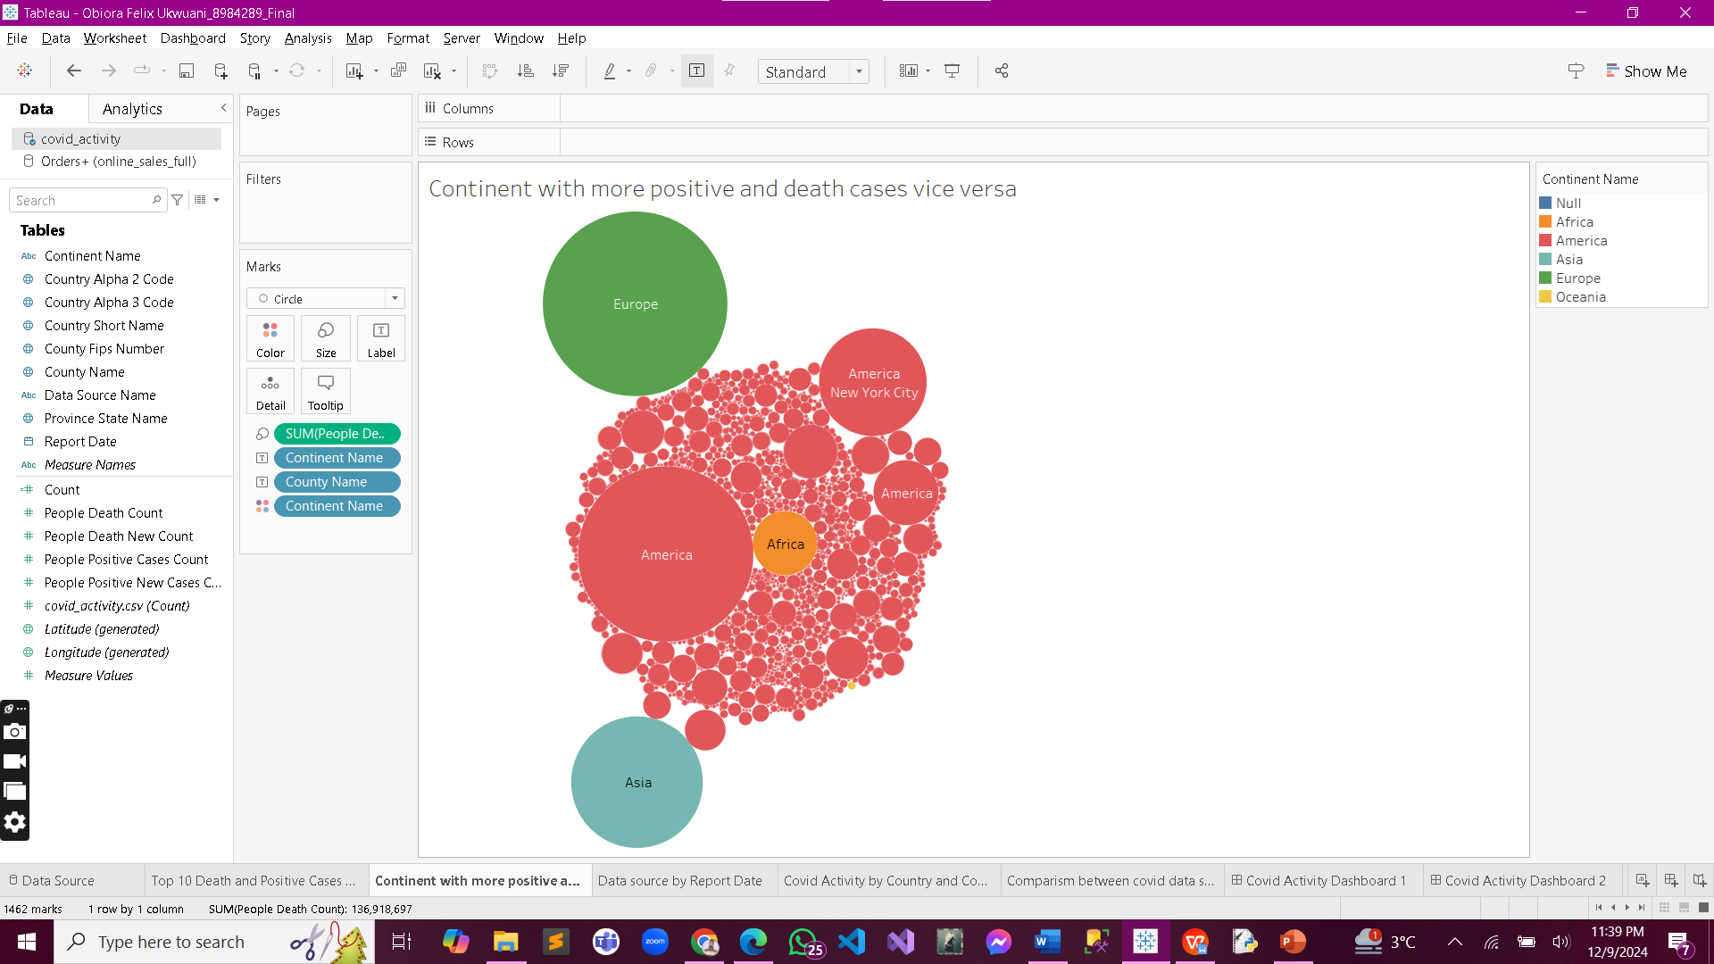
Continent with More Positive and Death Cases (Vice Versa)
A comparative analysis showing which continents experienced the most positive cases and deaths, offering insights into regional severity

Slide 6
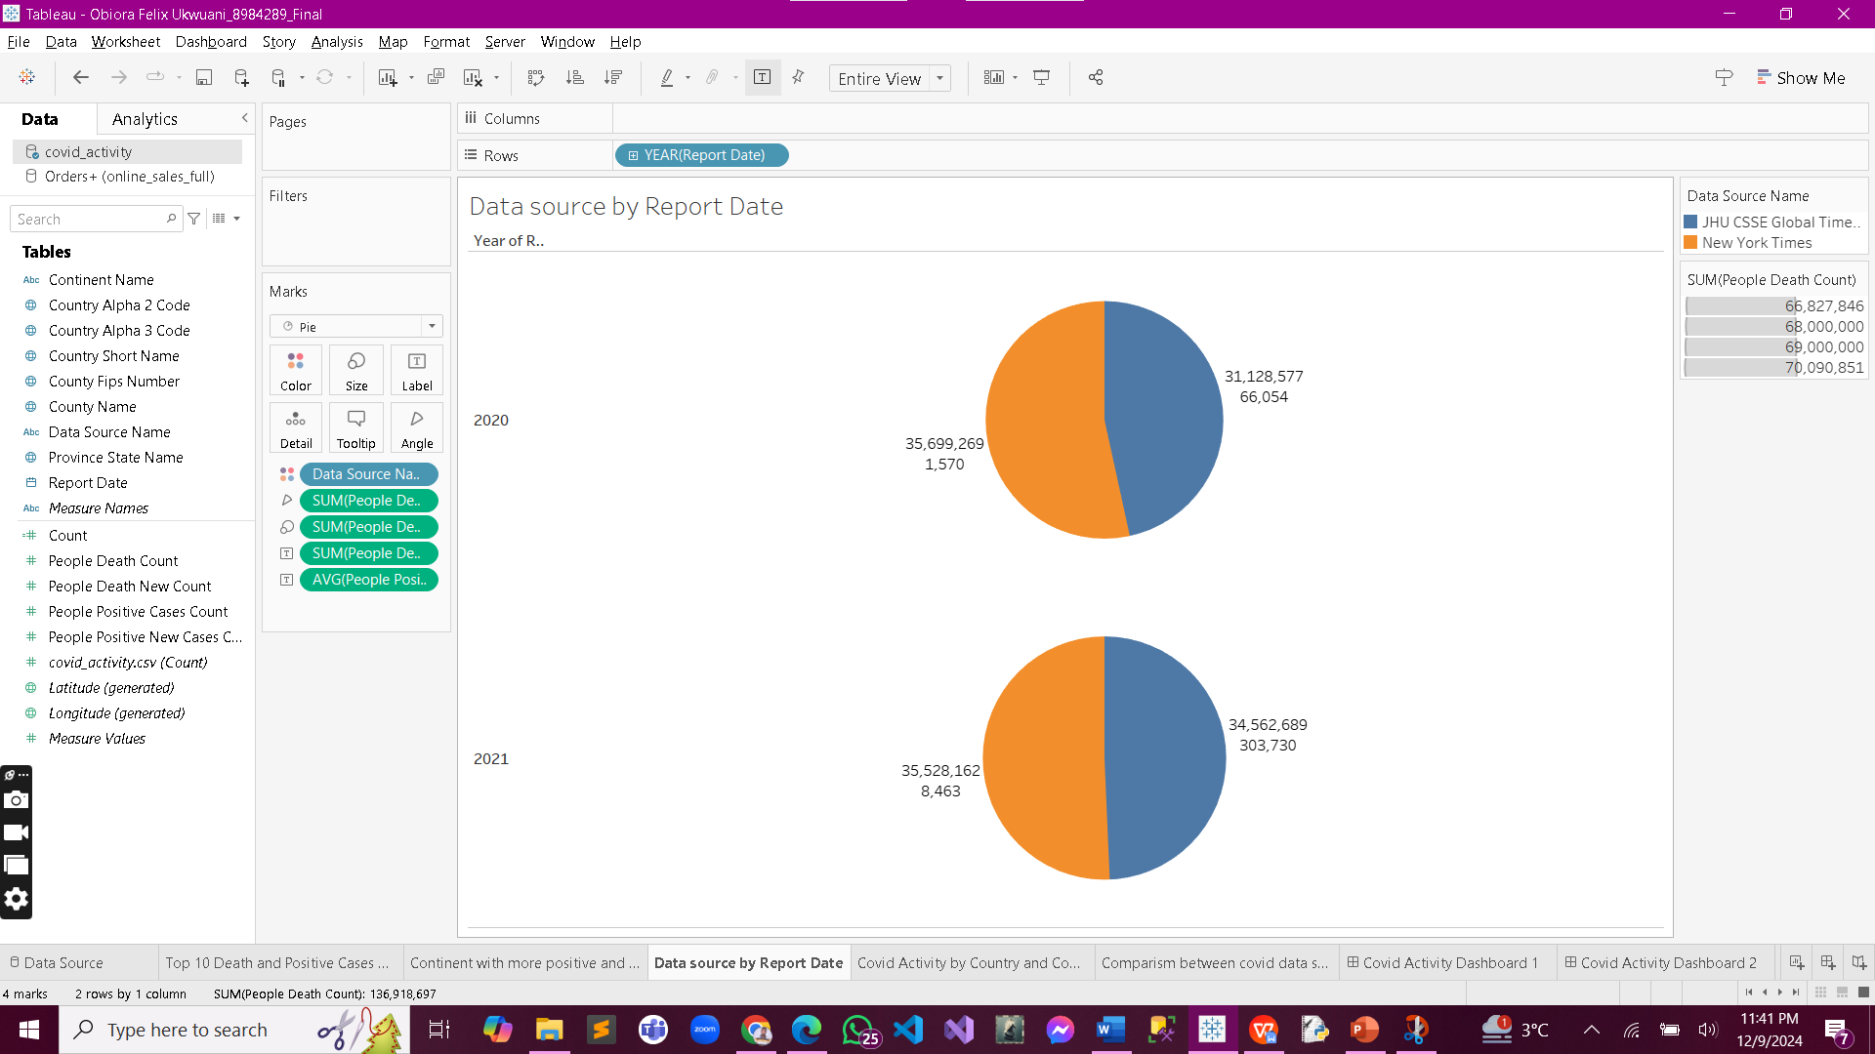
Data Source by Report Date
Tracks the contribution of various data sources over time, providing transparency and identifying trends in reported figures.

Slide 7
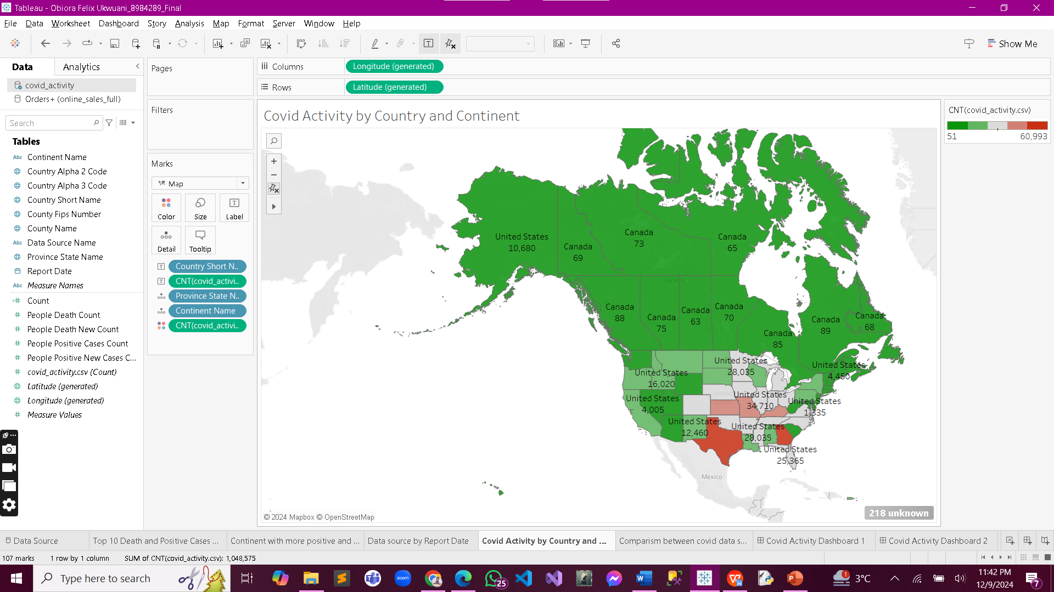
Covid Activity by Country and Continent
An overview of COVID-19 activity grouped by country and continent, showcasing geographical patterns of the pandemic

Slide 8
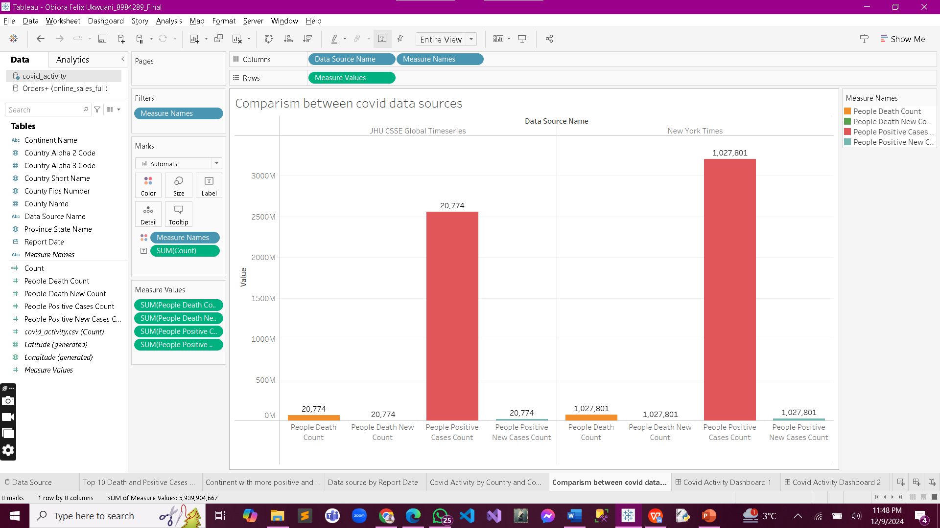
Comparison Between COVID Data Sources
Examines discrepancies or consistencies among different data sources, ensuring reliability and uncovering variations in reporting.

Slide 9
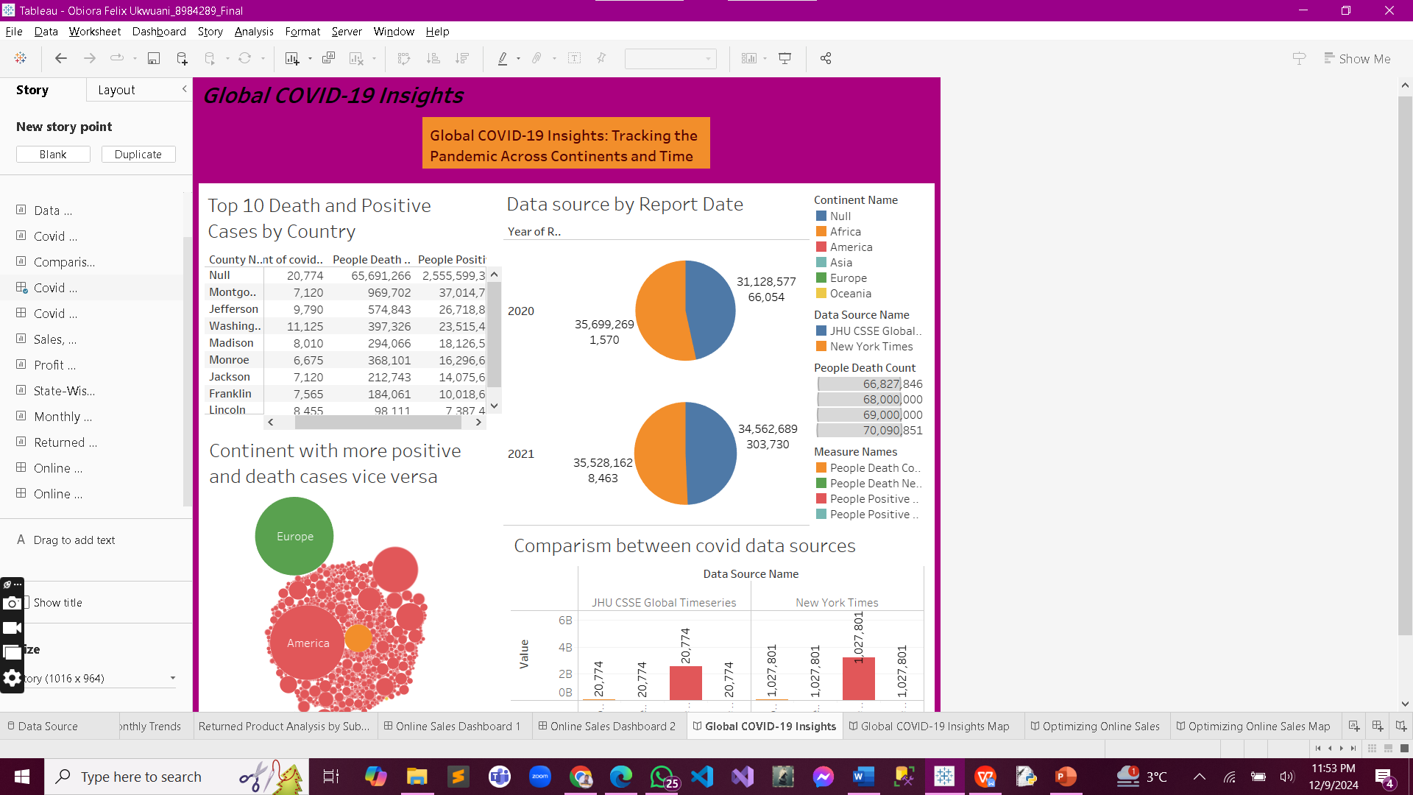
Covid Activity Dashboard with Filters
An interactive dashboard that allows stakeholders to explore COVID-19 data dynamically using filters like date range, continent, and country.

Slide 10
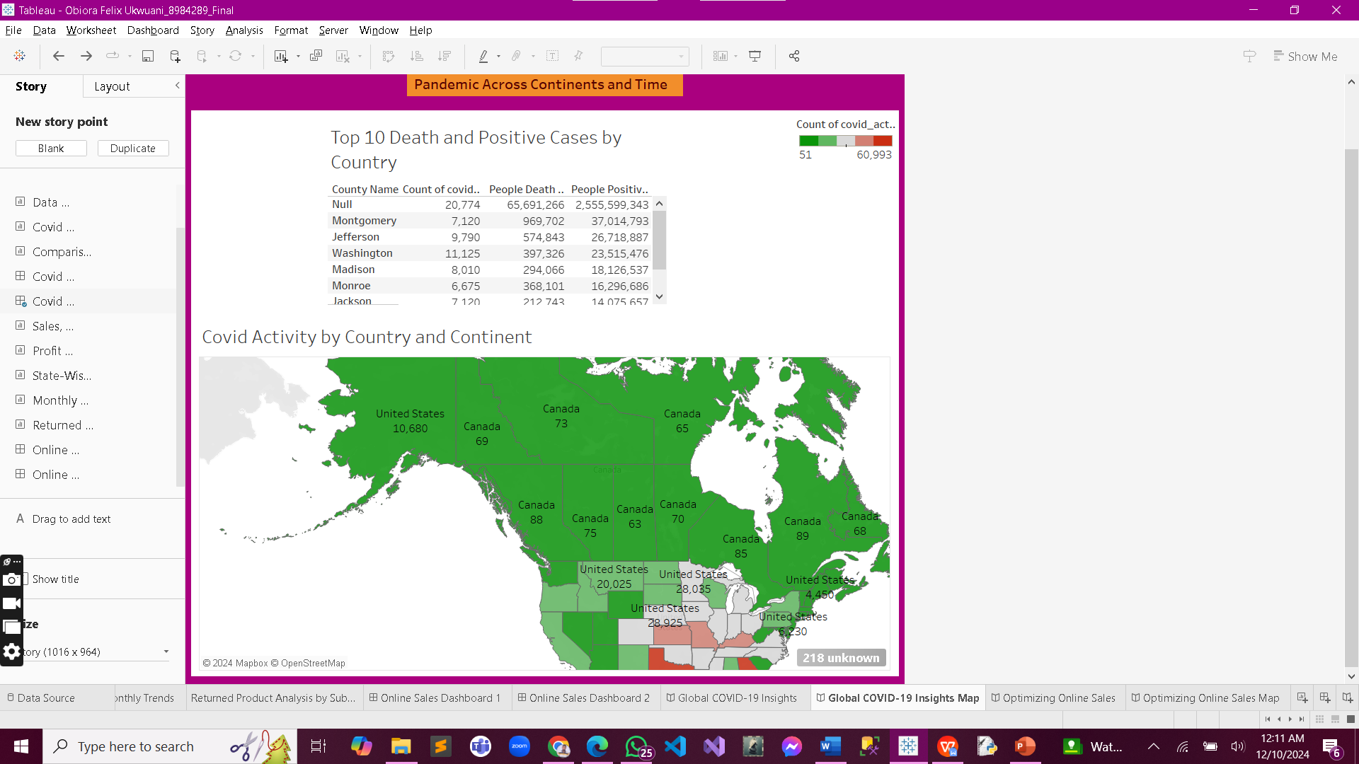
Covid Activity Dashboard with Filters
An interactive dashboard that allows stakeholders to explore COVID-19 data dynamically using filters like date range, continent, and country.

Slide 11
Online Sales Performance Analysis
The online sales performance analysis give more insights on understanding sales, profits, and customer behavior is key to success. This analysis looks at sales performance by category, region, and time, highlighting profit trends, product returns, and state-wise data. The interactive dashboards make it easy to explore and uncover insights to improve strategies and boost customer satisfaction.

Slide 12
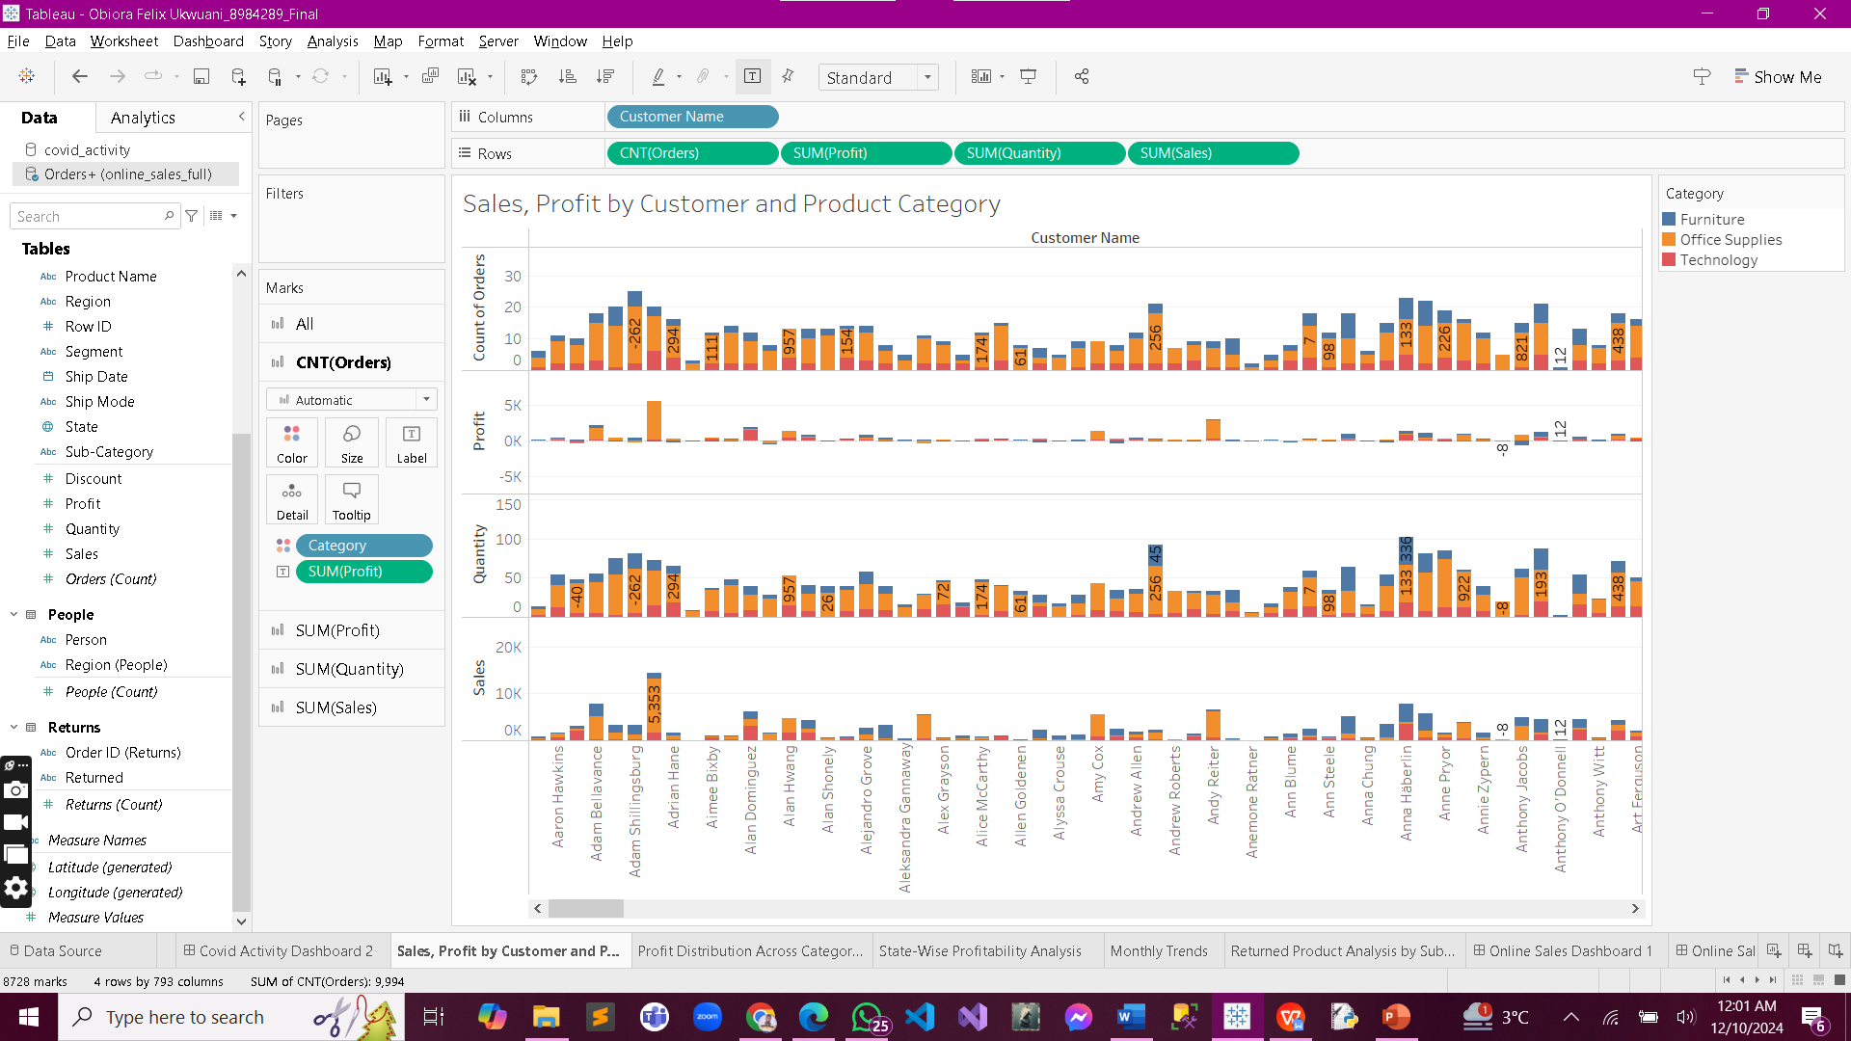
Sales, Profit by Customer and Product Category
Displays the relationship between sales and profit segmented by customer demographics and product categories, identifying
high-performing segments.

Slide 13
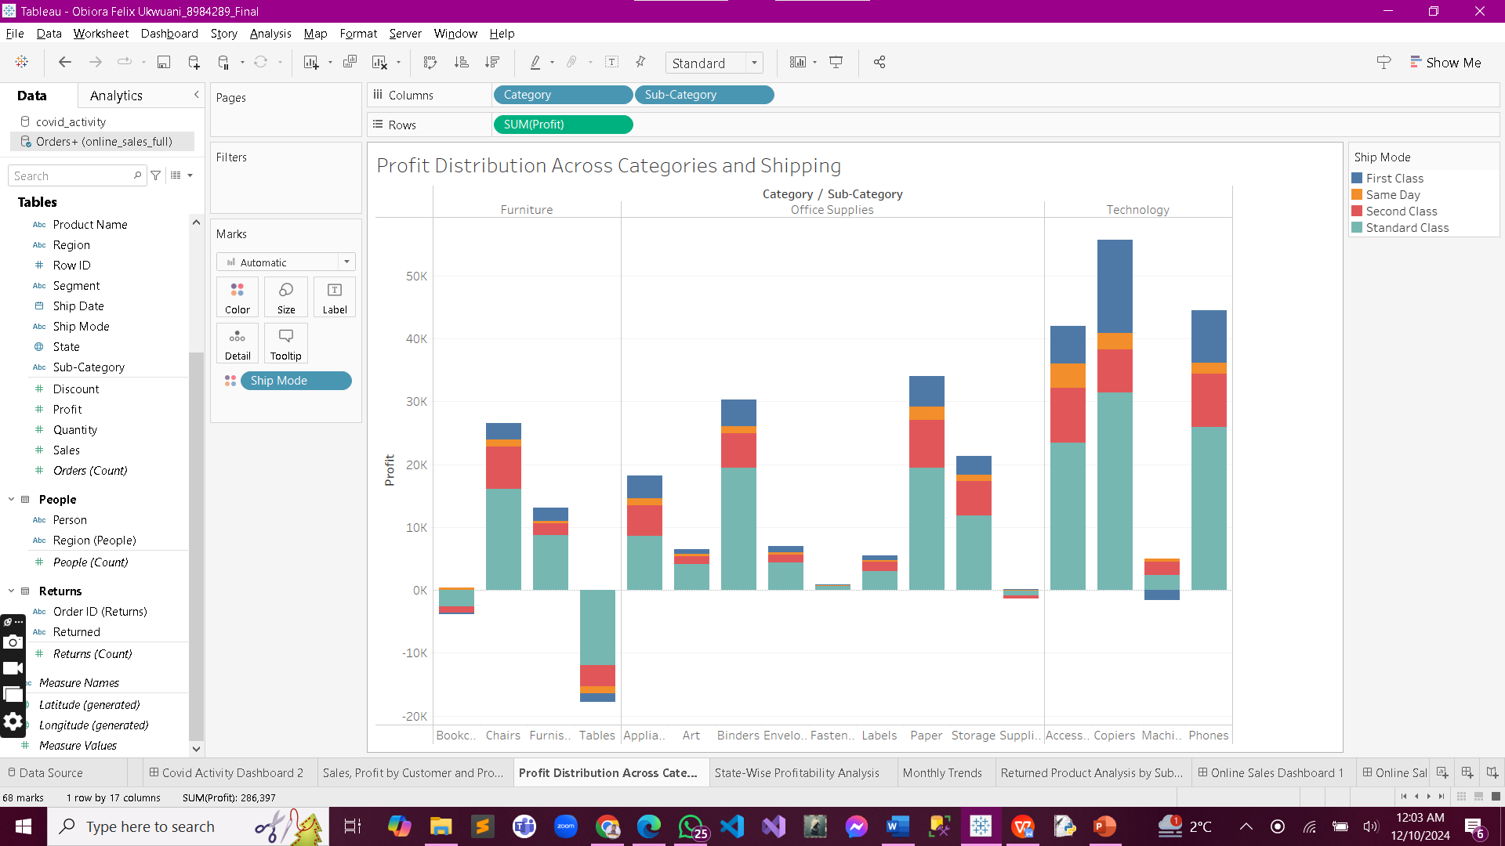
Profit Distribution Across Categories and Shipping
Analyzes more on how profit varies across product categories and shipping modes, uncovering key contributors to profitability.

Slide 14
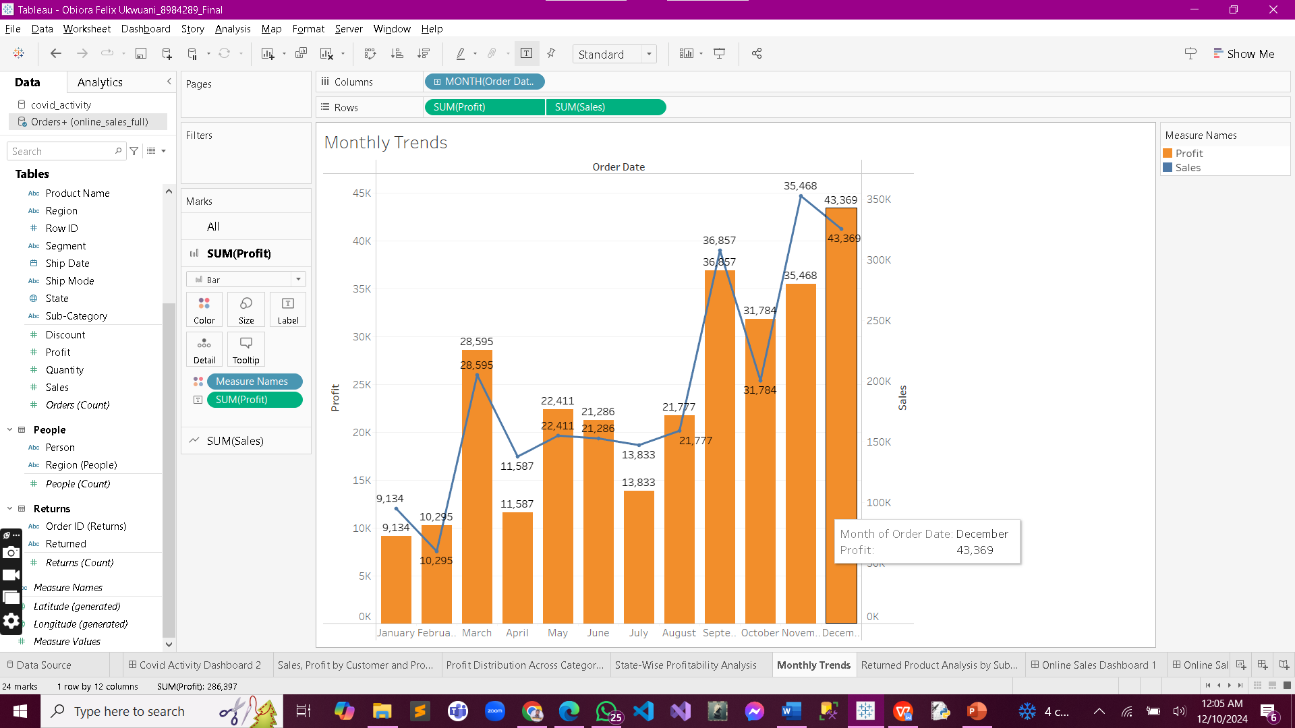
Monthly Trends
Charts sales and profit trends month by month, offering insights into seasonal performance and growth patterns.

Slide 15
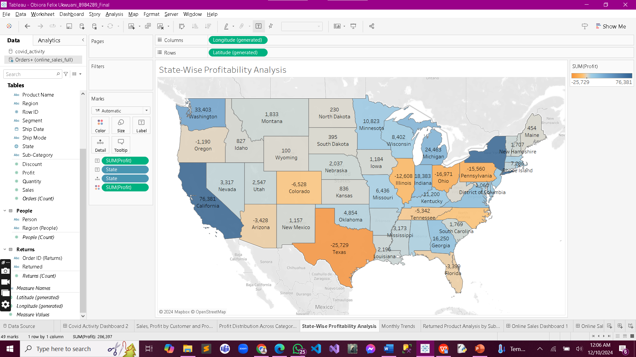
State-Wise Profitability Analysis
A geographic analysis showing profitability across states, helping identify regions of strong and weak performance.

Slide 16
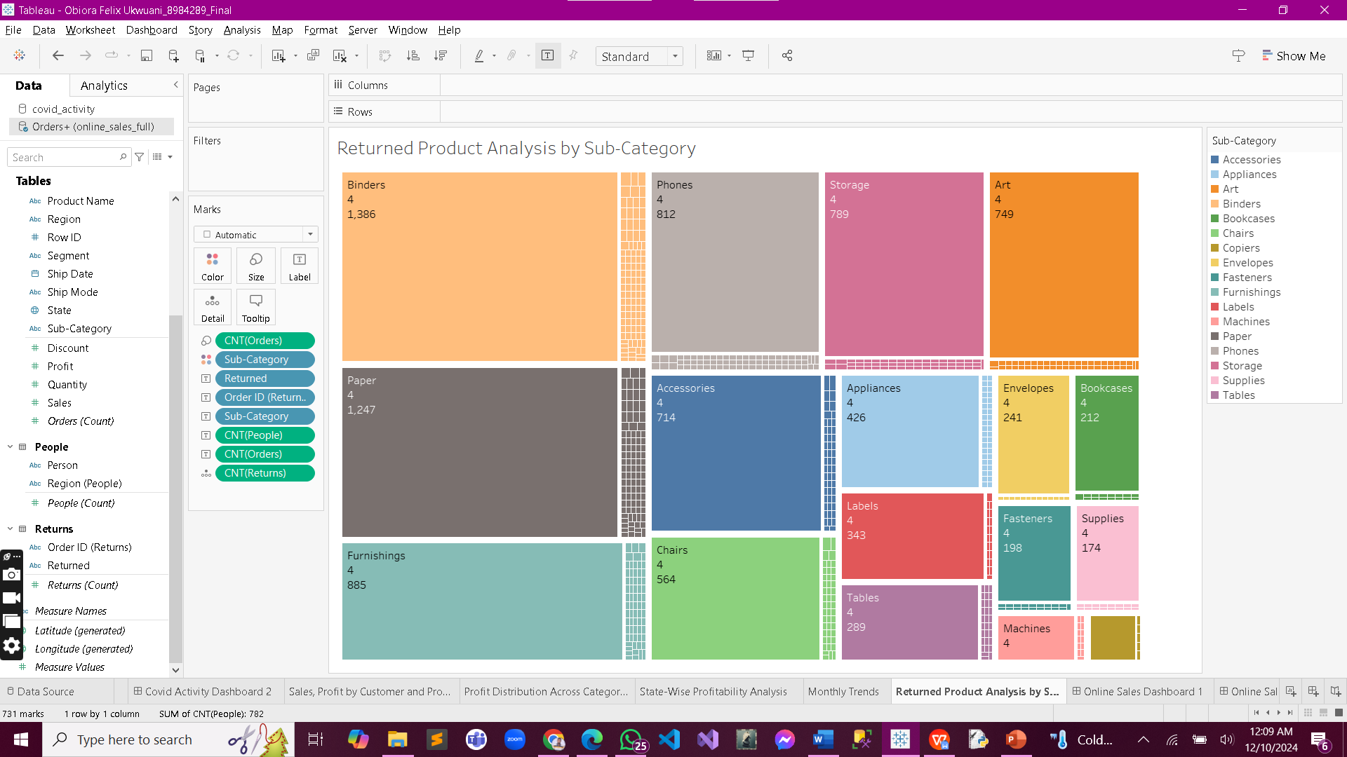
Returned Product Analysis by Sub-Category
Identifies which
sub-categories have the highest return rates,
helping refine inventory and customer satisfaction strategies.

Slide 17
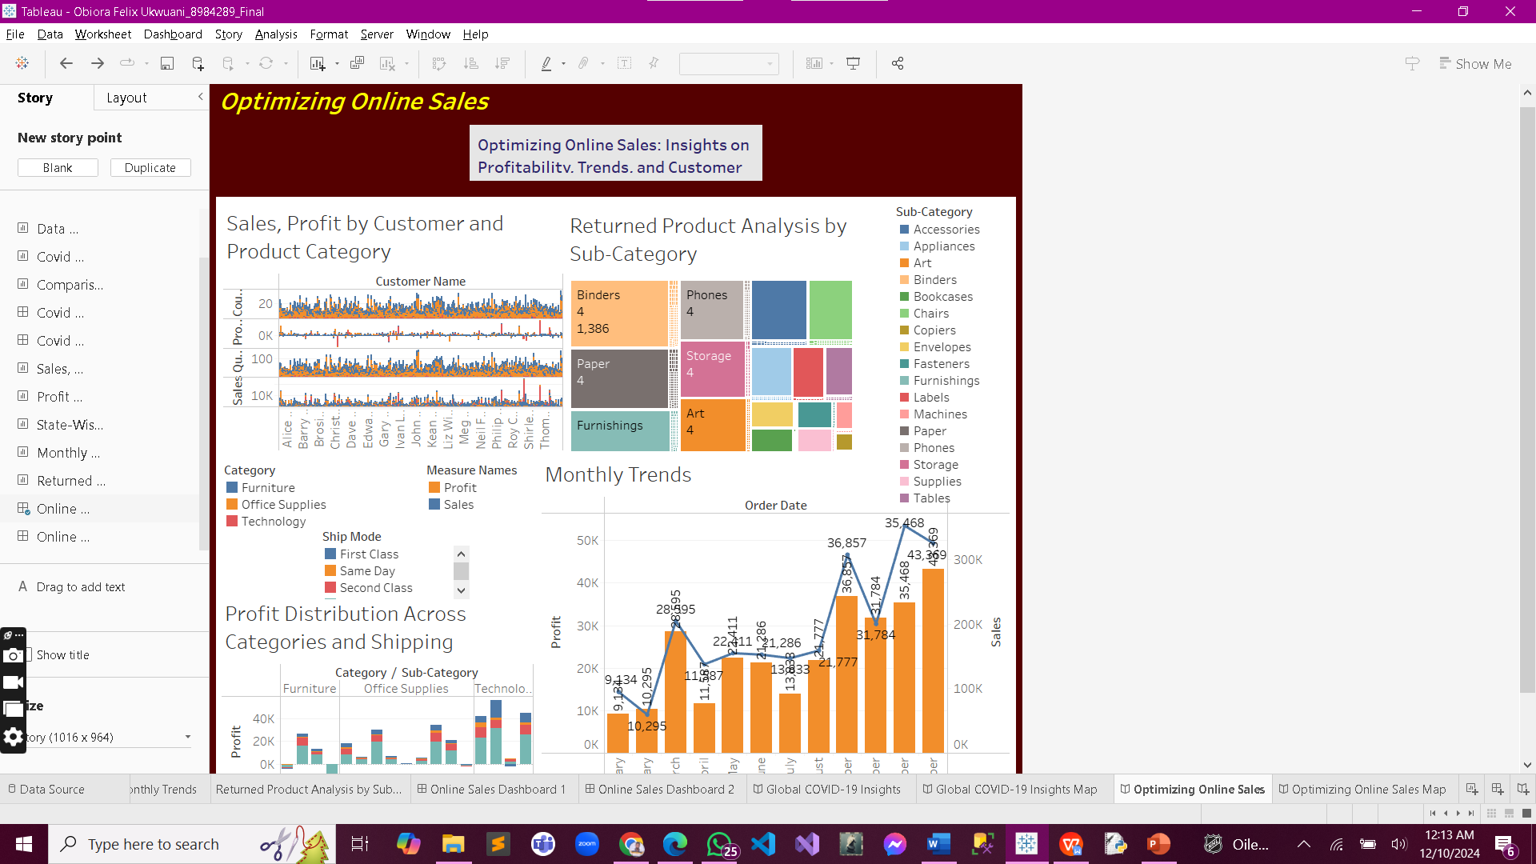
Online Sales Dashboard with Filters
A dynamic dashboard that enables users to filter data by product category, customer segment, time period, and region for deeper insights.

Slide 18
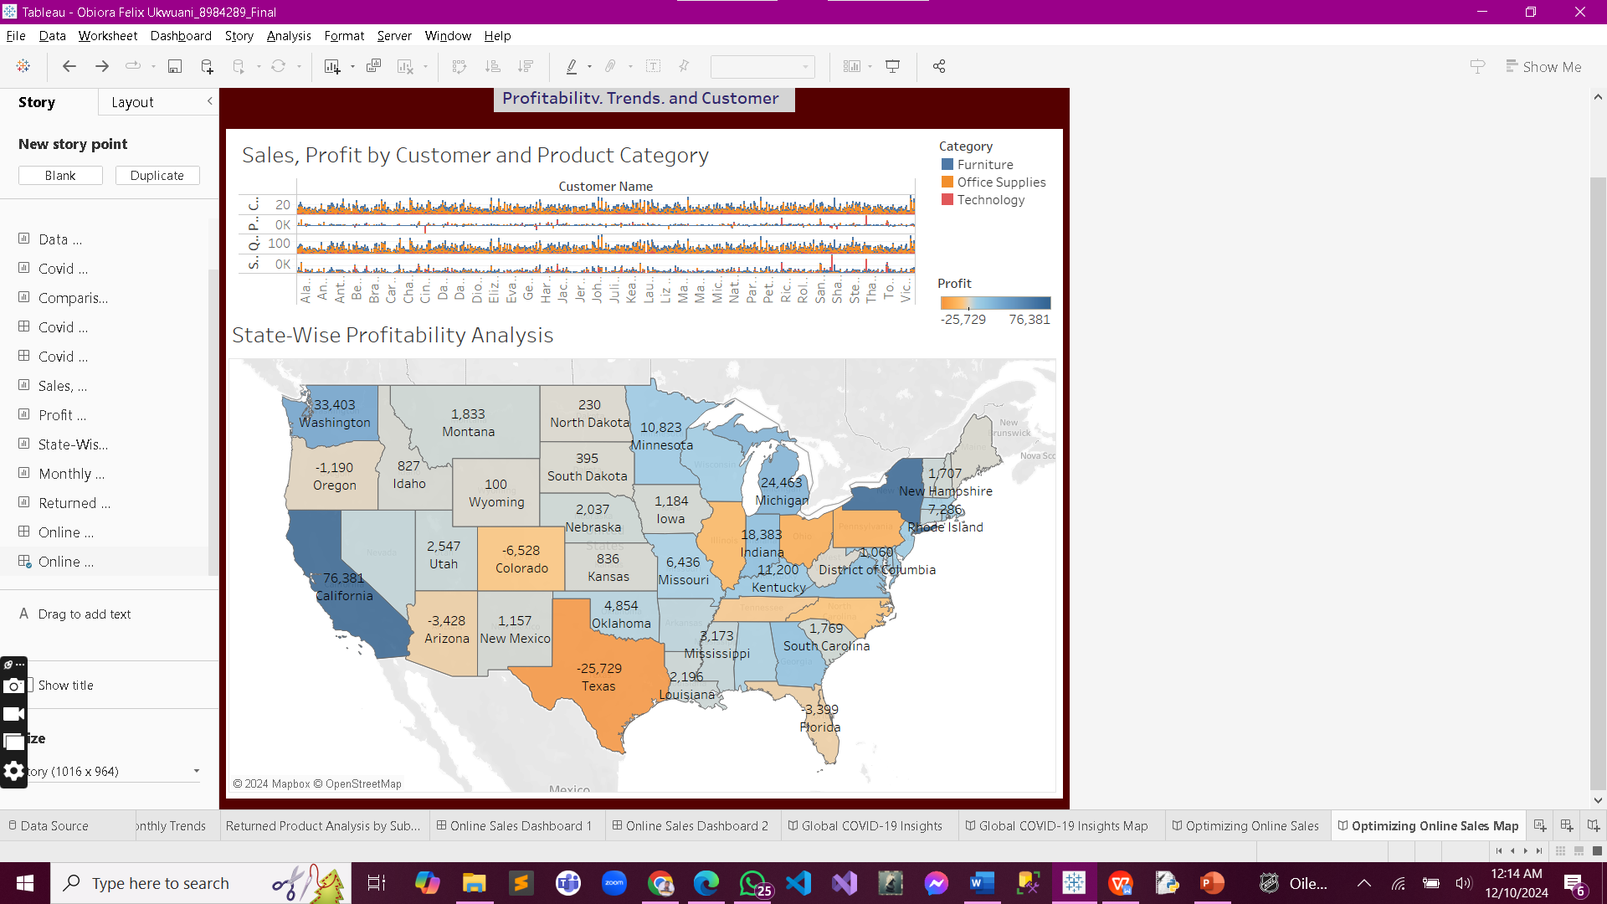
Online Sales Dashboard with Filters
A dynamic dashboard that enables users to filter data by product category, customer segment, time period, and region for deeper insights.

Slide 19
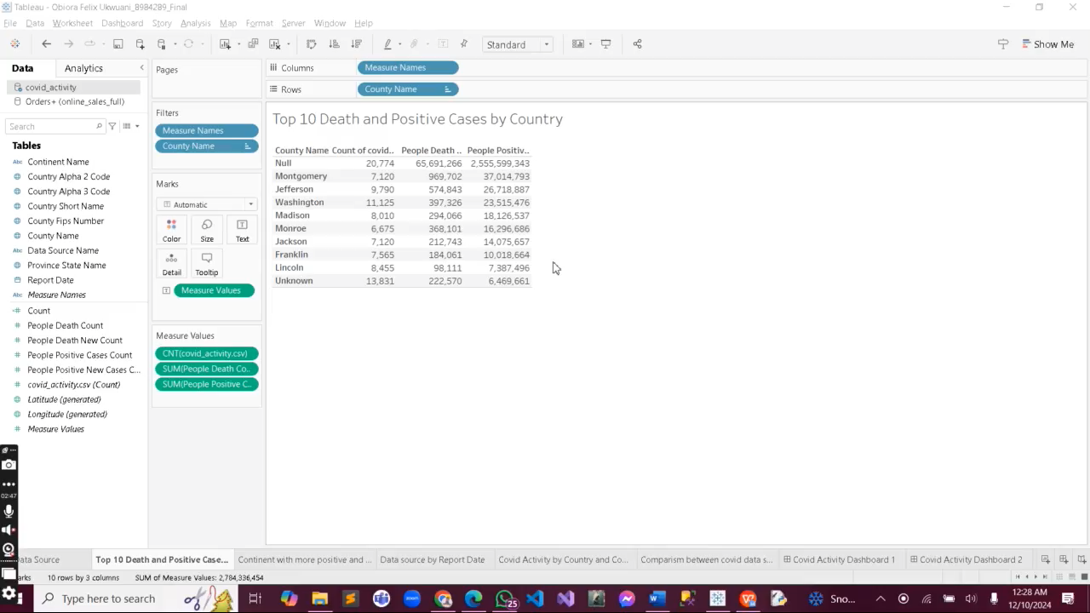
Video Demo - Data-Driven Insights: COVID-19 Trends and Online Sales Performance Analysis

Slide 20
COVID-19 Analysis: Countries and continents with the highest cases and deaths revealed the pandemic's uneven global impact. Reliable data sources are crucial for accurate tracking.
Online Sales Analysis: Profitability varies significantly by category, region, and shipping mode. Seasonal trends and high-return subcategories highlight areas for improvement.
General Insights

Slide 21
COVID-19: Focus resources on hardest-hit regions and improve data reporting for better decision-making. Online Sales: Optimize high-performing categories, address return issues, and target underperforming regions to maximize profitability.
Recommendations

Slide 22
Conclusions
The analyses provide actionable insights into global health challenges and online sales performance. By leveraging these findings, stakeholders can enhance strategies, improve resource allocation, and make data-driven decisions for better outcomes.

